Slide 1
Defensa Hito 3
Alumno: Samuel Alejandro maldonado garcia

Slide 2
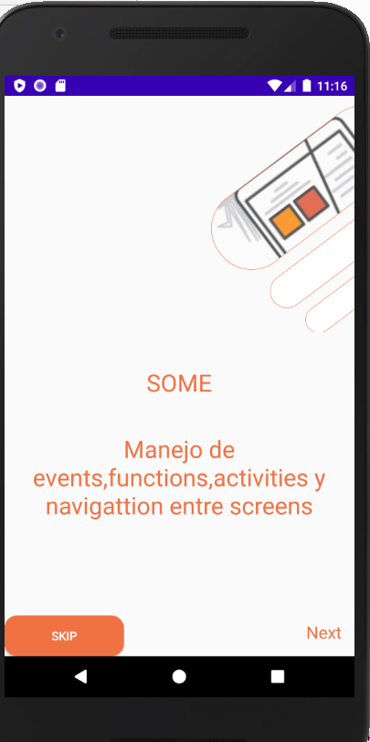
Crear una APP Android de nombre (DefensaHito3), generar las primeras ACTIVITIES(Pantalla 1 y 2) de la aplicación. Debe estar presente diseño y funcionalidad.
<TextView android:id="@+id/textlar" android:layout_width="match_parent" android:layout_height="wrap_content" android:layout_marginTop="40dp" android:fontFamily="sans-serif" android:gravity="center" android:text="@string/manejo" android:textColor="@color/colorPrimary" android:textSize="28sp" /> <LinearLayout android:id="@+id/layoutNext" android:layout_width="match_parent" android:layout_height="match_parent" android:orientation="horizontal"> <Button android:id="@+id/skip1" android:layout_width="141dp" android:layout_height="wrap_content" android:layout_gravity="bottom|start" android:background="@drawable/stylesnt" android:text="@string/skip" android:textColor="@color/colorWhite"> </Button> <TextView android:id="@+id/textInc" android:layout_width="wrap_content" android:layout_height="wrap_content" android:layout_gravity="bottom|start" android:layout_marginRight="15dp" android:layout_marginBottom="2dp" android:layout_weight="1" android:clickable="true" android:focusable="true" android:fontFamily="sans-serif" android:gravity="bottom|end" android:text="@string/done" android:textColor="@color/colorPrimary" android:textSize="20sp"/> </LinearLayout> </LinearLayout>
<?xml version="1.0" encoding="utf-8"?> <LinearLayout xmlns:android="http://schemas.android.com/apk/res/android" xmlns:tools="http://schemas.android.com/tools" android:layout_width="match_parent" android:layout_height="match_parent" tools:context=".Onboarding.n1" android:orientation="vertical"> <ImageView android:id="@+id/ima" android:layout_width="wrap_content" android:layout_height="277dp" android:layout_gravity="center" android:layout_marginLeft="150dp" android:layout_marginTop="1dp" android:scaleType="centerCrop" android:src="@drawable/img1" /> <TextView android:id="@+id/textTitle1" android:layout_width="match_parent" android:layout_height="wrap_content" android:layout_marginTop="40dp" android:fontFamily="sans-serif" android:gravity="center" android:text="@string/titulo" android:textColor="@color/colorPrimary" android:textSize="28sp" />
Manda a la pantalla 3
Pasa a la pantalla 2

Slide 3
Código Java pantalla 1
package com.example.examenhito3.Onboarding; public class n1 extends Fragment { private ViewPager viewPager; private View view; TextView textNextFace; Button Next; public n1() { // Required empty public constructor } @Override public View onCreateView(LayoutInflater inflater, ViewGroup container, Bundle savedInstanceState) { //initialize viewpager from main activity initializeInflater(inflater, container); //initialize components initializeComponents(); //add click event to text Next and prev text addClickNextAndPrev(); //return return view; }
public void initializeInflater(LayoutInflater inflater, ViewGroup container) { view = inflater.inflate(R.layout.fragment_n1, container, false); } public void initializeComponents() { viewPager = getActivity().findViewById(R.id.viewPagerContainer); textNextFace = view.findViewById(R.id.textInc); Next=view.findViewById(R.id.skip1); } public void addClickNextAndPrev() { textNextFace.setOnClickListener(new View.OnClickListener() { @Override public void onClick(View v) { viewPager.setCurrentItem(1); } }); Next.setOnClickListener(new View.OnClickListener() { @Override public void onClick(View v) { viewPager.setCurrentItem(2); } }); } }

Slide 4
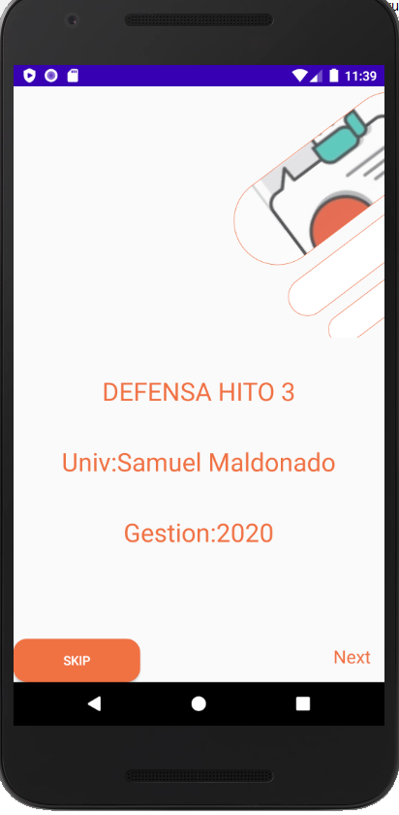
<?xml version="1.0" encoding="utf-8"?> <LinearLayout xmlns:android="http://schemas.android.com/apk/res/android" xmlns:tools="http://schemas.android.com/tools" android:layout_width="match_parent" android:layout_height="match_parent" tools:context=".Onboarding.n2" android:orientation="vertical"> <ImageView android:id="@+id/ima" android:layout_width="wrap_content" android:layout_height="277dp" android:layout_gravity="center" android:layout_marginLeft="150dp" android:layout_marginTop="1dp" android:scaleType="centerCrop" android:src="@drawable/img2" /> <TextView android:id="@+id/textTitle1" android:layout_width="match_parent" android:layout_height="wrap_content" android:layout_marginTop="40dp" android:fontFamily="sans-serif" android:gravity="center" android:text="@string/titulo2" android:textColor="@color/colorPrimary" android:textSize="28sp" />
<TextView android:id="@+id/textlar" android:layout_width="match_parent" android:layout_height="wrap_content" android:layout_marginTop="40dp" android:fontFamily="sans-serif" android:gravity="center" android:text="@string/manejo2" android:textColor="@color/colorPrimary" android:textSize="28sp" />
<TextView android:id="@+id/gest" android:layout_width="match_parent" android:layout_height="wrap_content" android:layout_marginTop="40dp" android:fontFamily="sans-serif" android:gravity="center" android:text="@string/estion" android:textColor="@color/colorPrimary" android:textSize="28sp" /> <LinearLayout android:id="@+id/layoutNext" android:layout_width="match_parent" android:layout_height="match_parent" android:orientation="horizontal"> <Button android:id="@+id/skip2" android:layout_width="141dp" android:layout_height="wrap_content" android:layout_gravity="bottom|start" android:background="@drawable/stylesnt" android:text="@string/skip" android:textColor="@color/colorWhite"> </Button> <TextView android:id="@+id/textInc2" android:layout_width="wrap_content" android:layout_height="wrap_content" android:layout_gravity="bottom|start" android:layout_marginRight="15dp" android:layout_marginBottom="2dp" android:layout_weight="1" android:clickable="true" android:focusable="true" android:fontFamily="sans-serif" android:gravity="bottom|end" android:text="@string/done" android:textColor="@color/colorPrimary" android:textSize="20sp" /> </LinearLayout> </LinearLayout>
Manda a la pantalla 3
Pasa a la pantalla 2

Slide 5
Código Java pantalla 2
public void initializeInflater(LayoutInflater inflater, ViewGroup container) { view = inflater.inflate(R.layout.fragment_n2, container, false); } public void initializeComponents() { viewPager = getActivity().findViewById(R.id.viewPagerContainer); textNextFace2 = view.findViewById(R.id.textInc2); Next2=view.findViewById(R.id.skip2); } public void addClickNextAndPrev() { textNextFace2.setOnClickListener(new View.OnClickListener() { @Override public void onClick(View v) { viewPager.setCurrentItem(2); } }); Next2.setOnClickListener(new View.OnClickListener() { @Override public void onClick(View v) { viewPager.setCurrentItem(2); } }); } }
public class n2 extends Fragment { private ViewPager viewPager; private View view; TextView textNextFace2; Button Next2; public n2() { // Required empty public constructor } @Override public View onCreateView(LayoutInflater inflater, ViewGroup container, Bundle savedInstanceState) { initializeInflater(inflater, container); //initialize components initializeComponents(); //add click event to text Next and prev text addClickNextAndPrev(); //return return view; }

Slide 6
Adapter
public class OnboardingAdapter extends FragmentPagerAdapter { public OnboardingAdapter(FragmentManager fm) { super(fm); } @NonNull @Override public Fragment getItem(int position) { switch (position) { case 0: return new n1(); case 1: return new n2(); case 2: return new n3(); default: return null; } } @Override public int getCount() { return 3; } }
Esto es para declarar las posiciones de los fragments

Slide 7
Java Main
public class MainActivity extends AppCompatActivity { private ViewPager viewPagerContainer; @Override protected void onCreate(Bundle savedInstanceState) { super.onCreate(savedInstanceState); setContentView(R.layout.activity_main); //initializeComponents _initializeComponents(); //initializeAdapter _initializeFragmentAdapter(); } public void _initializeComponents() { viewPagerContainer = findViewById(R.id.viewPagerContainer); } public void _initializeFragmentAdapter() { OnboardingAdapter adapter = new OnboardingAdapter(getSupportFragmentManager()); viewPagerContainer.setAdapter(adapter); } }

Slide 8
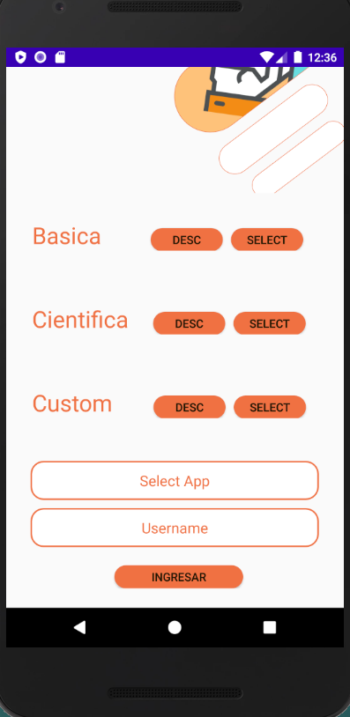
Generar la ACTIVITY de acceso a la aplicación. Debe estar presente diseño y funcionalidad.
<Button android:id="@+id/d1" android:layout_width="wrap_content" android:layout_height="28dp" android:layout_marginLeft="60dp" android:background="@drawable/stylesnt" android:text="@string/Dex" /> <Button android:id="@+id/s1" android:layout_width="wrap_content" android:layout_height="28dp" android:layout_marginLeft="10dp" android:background="@drawable/stylesnt" android:text="@string/select" /> </LinearLayout> <LinearLayout android:layout_width="match_parent" android:layout_height="wrap_content" android:orientation="horizontal" android:padding="32dp"> <TextView android:layout_width="wrap_content" android:layout_height="wrap_content" android:fontFamily="sans-serif" android:text="@string/asica1" android:textColor="@color/colorPrimary" android:textSize="28sp" /> <Button android:id="@+id/d2" android:layout_width="wrap_content" android:layout_height="28dp" android:layout_marginLeft="30dp" android:background="@drawable/stylesnt" android:text="@string/Dex" /> <Button android:id="@+id/s2" android:layout_width="wrap_content" android:layout_height="28dp" android:layout_marginLeft="10dp" android:background="@drawable/stylesnt" android:text="@string/select" />
<?xml version="1.0" encoding="utf-8"?> <LinearLayout xmlns:android="http://schemas.android.com/apk/res/android" xmlns:tools="http://schemas.android.com/tools" android:layout_width="match_parent" android:layout_height="match_parent" tools:context=".Onboarding.n1" android:orientation="vertical"> <LinearLayout android:layout_width="match_parent" android:layout_height="154dp" android:gravity="center" android:orientation="horizontal"> <ImageView android:id="@+id/ima" android:layout_width="wrap_content" android:layout_height="277dp" android:layout_gravity="center" android:layout_marginLeft="200dp" android:layout_marginBottom="50dp" android:scaleType="centerCrop" android:src="@drawable/img3" /> </LinearLayout> <LinearLayout android:layout_width="match_parent" android:layout_height="wrap_content" android:orientation="horizontal" android:padding="32dp"> <TextView android:layout_width="wrap_content" android:layout_height="wrap_content" android:fontFamily="sans-serif" android:text="@string/asica" android:textColor="@color/colorPrimary" android:textSize="28sp" />

Slide 9
<EditText android:id="@+id/etselect" android:layout_width="match_parent" android:layout_height="wrap_content" android:layout_gravity="center" android:layout_marginLeft="30dp" android:layout_marginTop="20dp" android:layout_marginRight="30dp" android:background="@drawable/et_style" android:fontFamily="sans-serif" android:hint="@string/selecapp" android:textColorHint="@color/colorPrimary" android:inputType="textEmailAddress" android:textAlignment="center"> </EditText> <EditText android:id="@+id/etUsername" android:layout_width="match_parent" android:layout_height="wrap_content" android:layout_gravity="center" android:layout_marginLeft="30dp" android:layout_marginTop="10dp" android:layout_marginRight="30dp" android:background="@drawable/et_style" android:fontFamily="sans-serif" android:hint="@string/username" android:textColorHint="@color/colorPrimary" android:textAlignment="center"> </EditText> <LinearLayout android:layout_width="match_parent" android:layout_height="wrap_content" android:orientation="horizontal" android:padding="22dp" android:gravity="center"> <Button android:id="@+id/btnIn" android:layout_width="157dp" android:layout_height="28dp" android:layout_marginLeft="10dp" android:background="@drawable/stylesnt" android:text="@string/in" /> </LinearLayout> </LinearLayout>
</LinearLayout> <LinearLayout android:layout_width="match_parent" android:layout_height="wrap_content" android:orientation="horizontal" android:padding="32dp"> <TextView android:layout_width="wrap_content" android:layout_height="wrap_content" android:fontFamily="sans-serif" android:text="@string/asica2" android:textColor="@color/colorPrimary" android:textSize="28sp" /> <Button android:id="@+id/d3" android:layout_width="wrap_content" android:layout_height="28dp" android:layout_marginLeft="50dp" android:background="@drawable/stylesnt" android:text="@string/Dex" /> <Button android:id="@+id/s3" android:layout_width="wrap_content" android:layout_height="28dp" android:layout_marginLeft="10dp" android:background="@drawable/stylesnt" android:text="@string/select" /> </LinearLayout>

Slide 10
Código Java pantalla 2
public void initializeComponents() { viewPager = getActivity().findViewById(R.id.viewPagerContainer); d1 = view.findViewById(R.id.d1); d2 = view.findViewById(R.id.d2); d3 = view.findViewById(R.id.d3); s1 = view.findViewById(R.id.s1); s2 = view.findViewById(R.id.s2); s3 = view.findViewById(R.id.s3); etsel = view.findViewById(R.id.etselect); etUser = view.findViewById(R.id.etUsername); bti = view.findViewById(R.id.btnIn); } public void eventClickAction() { d1.setOnClickListener(new View.OnClickListener() { @Override public void onClick(View v) { Toast.makeText(getActivity(), "Calculadora con operaciones simples básica", Toast.LENGTH_SHORT).show(); } }); d2.setOnClickListener(new View.OnClickListener() { @Override public void onClick(View v) { Toast.makeText(getActivity(), "Calculadora con operaciones avanzadas", Toast.LENGTH_SHORT).show(); } }); d3.setOnClickListener(new View.OnClickListener() { @Override public void onClick(View v) { Toast.makeText(getActivity(), "Calculadora con operaciones para programadores", Toast.LENGTH_SHORT).show(); } });
public class n3 extends Fragment { private ViewPager viewPager; private View view; private Button bti,d1,d2,d3,s1,s2,s3; private EditText etsel,etUser; public n3() { // Required empty public constructor } @Override public View onCreateView(LayoutInflater inflater, ViewGroup container, Bundle savedInstanceState) { //initialize viewpager from main activity initializeInflater(inflater, container); //initialize components initializeComponents(); //add click event to text Next and prev text eventClickAction(); //return return view; } public void initializeInflater(LayoutInflater inflater, ViewGroup container) { view = inflater.inflate(R.layout.fragment_n3, container, false); }

Slide 11
bti.setOnClickListener(new View.OnClickListener() { @Override public void onClick(View v) { String selct = etsel.getText().toString().trim(); String username = etUser.getText().toString().trim(); if(username.equals("") || selct .equals("")) { Toast.makeText(getActivity(), "Ingrese Select/Username", Toast.LENGTH_SHORT).show(); } else if(selct.equals("Custom")) { Intent intent = new Intent(getActivity(), CalcCustom.class); intent.putExtra("US", username); intent.putExtra("AS", selct); startActivity(intent); getActivity().finish(); } else if(selct.equals("Basica")) { Intent intent = new Intent(getActivity(), CalcBasica.class); intent.putExtra("US", username); intent.putExtra("AS", selct); startActivity(intent); getActivity().finish(); } else if(selct.equals("Cientifica")) { Intent intent = new Intent(getActivity(), CalcCientiffica.class); intent.putExtra("US", username); intent.putExtra("AS", selct); startActivity(intent); getActivity().finish(); } else{ Toast.makeText(getActivity(), "Seleccione alguna calculadora", Toast.LENGTH_SHORT).show(); } } }); } }
s1.setOnClickListener(new View.OnClickListener() { @Override public void onClick(View v) { etsel.setText("Basica"); } }); s2.setOnClickListener(new View.OnClickListener() { @Override public void onClick(View v) { etsel.setText("Cientifica"); } }); s3.setOnClickListener(new View.OnClickListener() { @Override public void onClick(View v) { etsel.setText("Custom"); } });

Slide 12
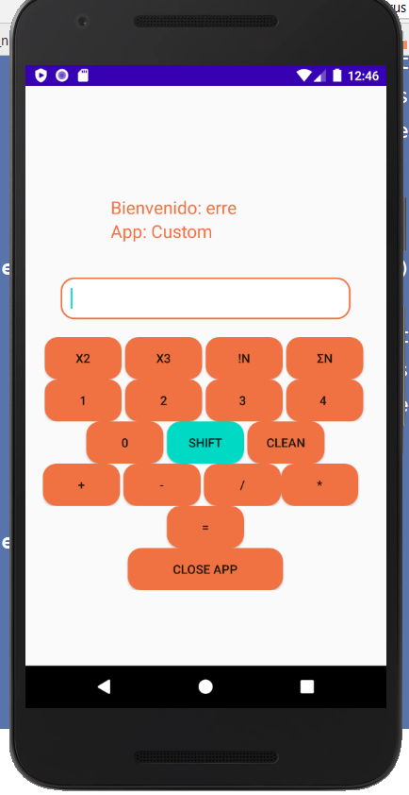
Implementar una APP calculadora CUSTOM.
<?xml version="1.0" encoding="utf-8"?> <LinearLayout xmlns:android="http://schemas.android.com/apk/res/android" xmlns:app="http://schemas.android.com/apk/res-auto" xmlns:tools="http://schemas.android.com/tools" android:layout_width="match_parent" android:layout_height="match_parent" tools:context=".MainActivity" android:orientation="vertical" android:gravity="center" android:layout_marginLeft="20dp" android:layout_marginRight="20dp" android:layout_marginTop="20dp"> <LinearLayout android:layout_width="254dp" android:layout_height="wrap_content" android:layout_gravity="center" android:orientation="vertical" android:padding="50px"> <TextView android:id="@+id/tvShowU2" android:layout_width="match_parent" android:layout_height="wrap_content" android:textColor="@color/colorPrimary" android:textSize="20sp"> </TextView> <TextView android:id="@+id/tvShowS2" android:layout_width="match_parent" android:layout_height="wrap_content" android:textColor="@color/colorPrimary" android:textSize="20sp"> </TextView> </LinearLayout>
<LinearLayout android:layout_width="match_parent" android:layout_height="wrap_content" android:orientation="vertical" android:layout_gravity="center" android:layout_marginTop="20dp"> <EditText android:id="@+id/txt" android:background="@drawable/et_style" android:layout_width="match_parent" android:layout_height="wrap_content" android:layout_marginRight="20dp" android:layout_marginLeft="20dp" android:layout_marginBottom="20dp"/> </LinearLayout> <LinearLayout android:layout_width="wrap_content" android:layout_height="wrap_content" android:orientation="vertical" android:layout_gravity="center"> <LinearLayout android:layout_width="match_parent" android:layout_height="wrap_content" android:orientation="horizontal" android:gravity="center"> <Button android:id="@+id/c1" android:layout_marginRight="10px" android:background="@drawable/stylesnt" android:layout_width="wrap_content" android:layout_height="wrap_content" android:text="x2" />

Slide 13
<Button android:id="@+id/c2" android:layout_marginRight="10px" android:background="@drawable/stylesnt" android:layout_width="wrap_content" android:layout_height="wrap_content" android:text="x3" /> <Button android:id="@+id/c3" android:layout_marginRight="10px" android:background="@drawable/stylesnt" android:layout_width="wrap_content" android:layout_height="wrap_content" android:text="!n" /> <Button android:id="@+id/c4" android:layout_marginRight="10px" android:background="@drawable/stylesnt" android:layout_width="wrap_content" android:layout_height="wrap_content" android:text="Σn" /> </LinearLayout> <LinearLayout android:layout_width="match_parent" android:layout_height="wrap_content" android:orientation="horizontal" android:gravity="center"> <Button android:id="@+id/nt1" android:layout_marginRight="10px" android:background="@drawable/stylesnt" android:layout_width="wrap_content" android:layout_height="wrap_content" android:text="1" />
<Button android:id="@+id/nt2" android:layout_marginRight="10px" android:background="@drawable/stylesnt" android:layout_width="wrap_content" android:layout_height="wrap_content" android:text="2" /> <Button android:id="@+id/nt3" android:layout_marginRight="10px" android:background="@drawable/stylesnt" android:layout_width="wrap_content" android:layout_height="wrap_content" android:text="3 " /> <Button android:id="@+id/nt4" android:layout_marginRight="10px" android:background="@drawable/stylesnt" android:layout_width="wrap_content" android:layout_height="wrap_content" android:text="4 " /> </LinearLayout> <LinearLayout android:layout_width="match_parent" android:layout_height="wrap_content" android:orientation="horizontal" android:gravity="center"> <Button android:id="@+id/nt0" android:layout_marginRight="10px" android:background="@drawable/stylesnt" android:layout_width="wrap_content" android:layout_height="wrap_content" android:text="0" />

Slide 14
<Button android:id="@+id/ntshf" android:layout_marginRight="10px" android:background="@drawable/shiftstyle" android:layout_width="wrap_content" android:layout_height="wrap_content" android:text="Shift" /> <Button android:id="@+id/ntclean" android:background="@drawable/stylesnt" android:layout_width="wrap_content" android:layout_height="wrap_content" android:text="Clean" /> </LinearLayout> </LinearLayout> <LinearLayout android:layout_width="match_parent" android:layout_height="wrap_content" android:orientation="horizontal"> <Button android:id="@+id/ntmas" android:layout_marginRight="10px" android:background="@drawable/stylesnt" android:layout_width="wrap_content" android:layout_height="wrap_content" android:text="@string/mas" /> <Button android:id="@+id/ntmenos" android:layout_marginRight="10px" android:background="@drawable/stylesnt" android:layout_width="wrap_content" android:layout_height="wrap_content" android:text="@string/menos" /> <Button android:id="@+id/ntdi" android:background="@drawable/stylesnt" android:layout_width="wrap_content" android:layout_height="wrap_content" android:text="@string/di" /> />
<Button android:id="@+id/ntmulti" android:layout_marginRight="10px" android:background="@drawable/stylesnt" android:layout_width="wrap_content" android:layout_height="wrap_content" android:text="@string/multi" />/> </LinearLayout> <LinearLayout android:layout_width="match_parent" android:layout_height="wrap_content" android:orientation="horizontal" android:gravity="center"> <Button android:id="@+id/ntiual" android:background="@drawable/stylesnt" android:layout_width="wrap_content" android:layout_height="wrap_content" android:text="=" /> </LinearLayout> <LinearLayout android:layout_width="match_parent" android:layout_height="wrap_content" android:orientation="horizontal" android:gravity="center"> <Button android:id="@+id/cls" android:layout_width="177dp" android:layout_height="wrap_content" android:background="@drawable/stylesnt" android:text="Close App" /> </LinearLayout> </LinearLayout>

Slide 15
Código Java calc Custom
Public class CalcCustom extends AppCompatActivity implements View.OnClickListener { private EditText txt; private Button cerrar, btn1,btn2,btn3,btn4,btn0,btncl,btnshift,btsuma,btnigual,btres,btmulti,btdi,cm1,cm2,cm3,cm4; int operaciones; double operan1,operan2; double operan3=1; double operan4=0; double resul; int clicks = 1; private TextView tvShowU2,tvShows2; @Override protected void onCreate(Bundle savedInstanceState) { super.onCreate(savedInstanceState); setContentView(R.layout.activity_calc_custom); initializeVariables(); } public void initializeVariables(){ tvShowU2 = findViewById(R.id.tvShowU2); tvShows2 = findViewById(R.id.tvShowS2); String username = getIntent().getStringExtra("US"); String select = getIntent().getStringExtra("AS"); String msg1 = "App: " + select; String msg = "Bienvenido: " + username; tvShowU2.setText(msg); tvShows2.setText(msg1);
btn1 = findViewById(R.id.nt1); btn2=findViewById(R.id.nt2); btn3 = findViewById(R.id.nt3); btn4 = findViewById(R.id.nt4); btn0=findViewById(R.id.nt0); btsuma= findViewById(R.id.ntmas); btres= findViewById(R.id.ntmenos); btmulti=findViewById(R.id.ntmulti); btdi=findViewById(R.id.ntdi); txt = findViewById(R.id.txt); btnigual=findViewById(R.id.ntiual); btnshift=findViewById(R.id.ntshf); cm1=findViewById(R.id.c1); cm2=findViewById(R.id.c2); cm3=findViewById(R.id.c3); cm4=findViewById(R.id.c4); cerrar=findViewById(R.id.cls); btncl=findViewById(R.id.ntclean); cerrar.setOnClickListener(this); btncl.setOnClickListener(this); btnigual.setOnClickListener(this); btn1.setOnClickListener(this); btn2.setOnClickListener(this); btn3.setOnClickListener(this); btn4.setOnClickListener(this); btnshift.setOnClickListener(this); cm1.setOnClickListener(this); cm2.setOnClickListener(this); cm3.setOnClickListener(this); cm4.setOnClickListener(this); btn0.setOnClickListener(this); btsuma.setOnClickListener(this); btres.setOnClickListener(this); btmulti.setOnClickListener(this); btdi.setOnClickListener(this); }

Slide 16
case R.id.nt4: String dato4 = txt.getText().toString(); dato4 = dato4 + "4"; txt.setText(dato4); break; case R.id.nt0: String dato3 = txt.getText().toString(); dato3 = dato3 + "0"; txt.setText(dato3); break; case R.id.ntmas: String sum = txt.getText().toString(); if (sum.equals("")) { Toast.makeText(this, "Introducir números", Toast.LENGTH_SHORT).show(); } else { operan1 = operan1 + Double.parseDouble(sum); txt.setText(""); operaciones = 1; } break; case R.id.ntmenos: operan1 = 0; if (operan4 < 1) { String auxi = txt.getText().toString(); operan1 = Double.parseDouble(auxi) - operan1; operan3 = operan1; } else if (operan4 > 0) { String auxi = txt.getText().toString(); operan1 = operan3 - Double.parseDouble(auxi); } operan4++; txt.setText(""); operaciones = 2; break;
@Override public void onClick(View v) { switch (v.getId()) { case R.id.cls: finish(); break; case R.id.ntclean: txt.setText(""); break; case R.id.nt1: String dato = txt.getText().toString(); dato = dato + "1"; txt.setText(dato); break; case R.id.nt2: String dato1 = txt.getText().toString(); dato1 = dato1 + "2"; txt.setText(dato1); break; case R.id.nt3: String dato2 = txt.getText().toString(); dato2 = dato2 + "3"; txt.setText(dato2); break;

Slide 17
case R.id.ntmulti: operan1 = 1; String multi = txt.getText().toString(); operan1 = operan3 * Double.parseDouble(multi); operan3 = operan1; txt.setText(""); operaciones = 3; break; case R.id.ntdi: if (operan4 < 1) { String di = txt.getText().toString(); operan1 = Double.parseDouble(di) / operan3; operan3 = operan1; } else { String di = txt.getText().toString(); operan1 = operan3 / Double.parseDouble(di); operan3 = operan1; } operan4++; txt.setText(""); operaciones = 4; break; case R.id.c2: String auxcm4; auxcm4 = cm2.getText().toString(); if (auxcm4.equals("x3")) { Double res, res1; String cua = txt.getText().toString(); res = Double.parseDouble(cua); res1 = Math.pow(res, 3); txt.setText("" + res1); } else{ String par = txt.getText().toString(); operan1 = Double.parseDouble(par); txt.setText(""); operaciones = 5; } break;
case R.id.c1: String axcm1; axcm1 = cm1.getText().toString(); if (axcm1.equals("x2")) { Double res, res1; String cua = txt.getText().toString(); res = Double.parseDouble(cua); res1 = Math.pow(res, 2); txt.setText("" + res1); } else { Double res, res1; String cua = txt.getText().toString(); res = Double.parseDouble(cua); res1 = Math.pow(res, 3); txt.setText("" + res1); } break;

Slide 18
case R.id.c3: String auxcm3; auxcm3 = cm3.getText().toString(); if (auxcm3.equals("!n")) { double factorial = 1; String fac = txt.getText().toString(); Double op11 = Double.parseDouble(fac); for (double i = op11; i > 0; i--) { factorial = factorial * i; } txt.setText("" + factorial); } else{ try { String auxi = txt.getText().toString(); operan1 = Double.parseDouble(auxi); int cw =0; int w1 =1; int w2; int sums =0; for(double i = 1;i<=operan1;i++) { w2 = cw; cw = w1 +cw; w1 = w2; sums = sums + w1; } txt.setText(""+sums); operan1=0; } catch (Exception E) { Toast.makeText(getApplicationContext(),"Revise los datos",Toast.LENGTH_LONG).show(); } } break;
case R.id.c4: String acm4; acm4 = cm4.getText().toString(); if (acm4.equals("Σn")) { try { double ar=0; String auxi = txt.getText().toString(); Double aux11 = Double.parseDouble(auxi); for(Double i = aux11;i>0;i--) { ar = ar+i; } txt.setText(""+ar); } catch (Exception a) { Toast.makeText(getApplicationContext(),"Revise los datos",Toast.LENGTH_LONG).show(); }} else{ try { String auxi = txt.getText().toString(); operan1 = Double.parseDouble(auxi); txt.setText(""); operaciones=6; } catch (Exception a) { Toast.makeText(getApplicationContext(),"Revise los datos",Toast.LENGTH_LONG).show(); } } break;

Slide 19
case R.id.ntshf: clicks++; if(clicks%2==0){ datosbtones2(); } else { datosbtones1(); } break; case R.id.ntiual: String captura = txt.getText().toString(); if (captura.equals("")) { Toast.makeText(this, "Introducir números", Toast.LENGTH_SHORT).show(); } else{ operan2 = Double.parseDouble(captura); txt.setText(""); if (operaciones == 1) { resul = operan1 + operan2; } else if (operaciones == 2) { resul = operan1 - operan2; } else if (operaciones == 3) { resul = operan1 * operan2; } else if (operaciones == 4) { if (operaciones == 0) { txt.setText("Error al ingresar"); } else { resul = operan1 / operan2; } } else if (operaciones == 5) { resul =Math.pow(operan1,operan2); }
else if(operaciones==6) { for(Double i = operan1;i<=operan2;i++) { resul = resul+i; } } txt.setText("" + resul); operan1 = 0.0; operan3 = 1.0; operan4 = 0;} break; } }
public void datosbtones1(){ cm1.setText("x2"); cm2.setText("x3"); cm3.setText("!n"); cm4.setText("Σn"); } public void datosbtones2(){ cm1.setText("x3"); cm2.setText("XY"); cm3.setText("Σfibo"); cm4.setText("Σnxy"); } }

Slide 20
Strings
<string name="app_name">Examenhito3</string> <string name="titulo">SOME</string> <string name="titulo2">DEFENSA HITO 3</string> <string name="manejo2">Univ:Samuel Maldonado</string> <string name="estion">Gestion:2020</string> <string name="done">Next</string>> <string name="skip">Skip</string> <string name="asica">Basica</string> <string name="asica1">Cientifica</string> <string name="asica2">Custom</string> <string name="selecapp">Select App</string> <string name="username">Username</string> <string name="in">Ingresar</string> <string name="select">Select</string> <string name="Dex">Desc</string> <string name="manejo">Manejo de events,functions,activities y navigattion entre screens</string> <string name="mas">+</string> <string name="menos">-</string> <string name="multi">*</string> <string name="di">/</string> <string name="nume1">1</string> <string name="nume2">2</string> <string name="nume3">3</string> <string name="nume4">4</string> <string name="nume5">5</string> <string name="nume6">6</string> <string name="nume7">7</string> <string name="nume8">8</string> <string name="nume9">9</string> <string name="nume0">0</string> <string name="masmenos">+/-</string> <string name="punto">.</string>
<string name="iual">=</string> <string name="mass">+</string> <string name="menoss">-</string> <string name="multii">*</string> <string name="dis">/</string> <string name="c">C</string> <string name="c2">C2</string> <string name="flecha">(-</string> <string name="cuadrado">x2</string> <string name="porcentaje">%</string> <string name="R">R</string>

Slide 21
Estilos y colores
<color name="colorWhite">#FFFFFF</color> <color name="colorPrimary">#F07243 </color> <color name="colorPrimaryDark">#3700B3</color> <color name="colorAccent">#03DAC5</color>
<style name="AppTheme" parent="Theme.AppCompat.Light.NoActionBar"> <!-- Customize your theme here. --> <item name="colorPrimary">@color/colorPrimary</item> <item name="colorPrimaryDark">@color/colorPrimaryDark</item> <item name="colorAccent">@color/colorAccent</item> </style>
<?xml version="1.0" encoding="utf-8"?> <shape xmlns:android="http://schemas.android.com/apk/res/android"> <solid android:color="@color/colorAccent"/> <corners android:radius="15dp"/> <stroke android:width="1dp" android:color="@color/colorAccent"/> </shape>
<?xml version="1.0" encoding="utf-8"?> <shape xmlns:android="http://schemas.android.com/apk/res/android"> <solid android:color="@color/colorPrimary"/> <corners android:radius="15dp"/> <stroke android:width="1dp" android:color="@color/colorPrimary"/> </shape>

Slide 22
<?xml version="1.0" encoding="utf-8"?> <shape xmlns:android="http://schemas.android.com/apk/res/android"> <solid android:color="@color/colorWhite"></solid> <corners android:radius="15dp"></corners> <stroke android:width="2dp" android:color="@color/colorPrimary"></stroke> <padding android:top="12dp" android:bottom="12dp" android:left="12dp" android:right="12dp"></padding> </shape>

